Slide 1

Functions and debugging in R
Jaime Villacampa (Jaime.villacampa@phs.scot)
Principal Information Analyst - PHS

Slide 2
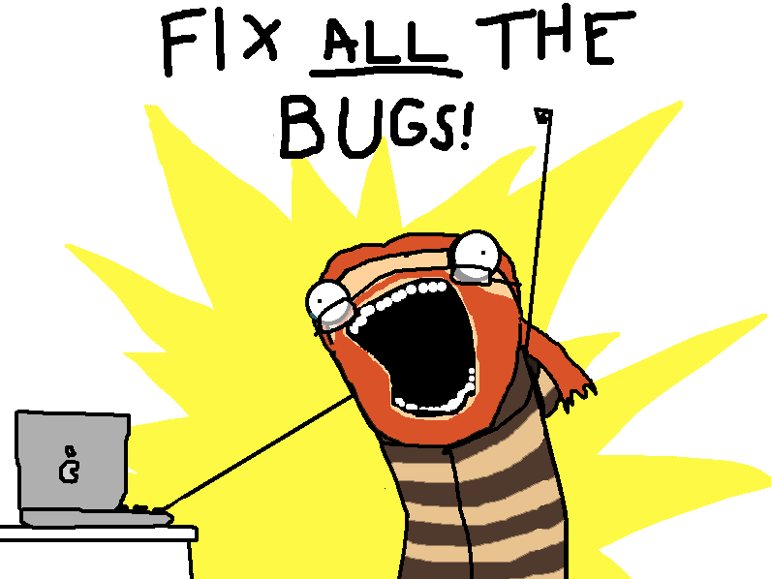
BIG Caveat
I am not very good at this…

Slide 3
Contents
Mini-intro to functions
Debugging code not in function
Debugging code in function:
Print
Debug
Traceback
Shiny vs R
Debugging in Shiny

Slide 4
Functions
Code snippets to avoid repetition.
Can have parameters to be more flexible.
Work in a different environment.

Slide 5
Debugging functions in R
Errors can be tricky to decipher.
Intermediate objects are innacessible.
Let’s go through some examples.

Slide 6
Shiny vs R
Similar, but a bit more difficult than in normal R
Reactive environment
Trace() doesn’t work

Slide 7
Console error
Check for the errors the console prints
Error messages when app is big are too long
What do they mean??!!

Slide 8
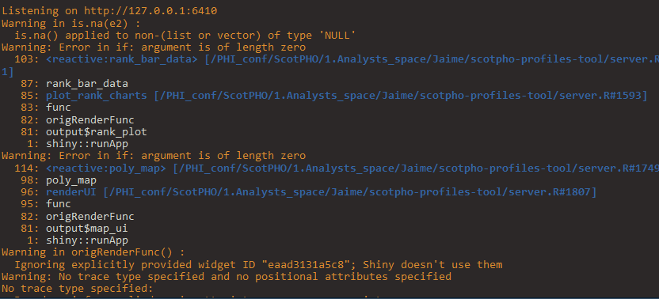
Console error

Slide 9
Primitive
Create things outside reactive environment, check they work and then add reactivity
Time consuming + needs transformation to reactive.

Slide 10
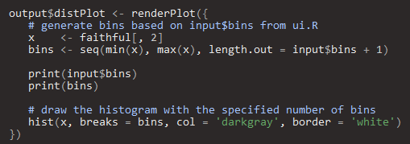
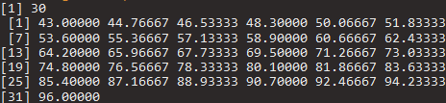
Printing results
Good for small things

Slide 11
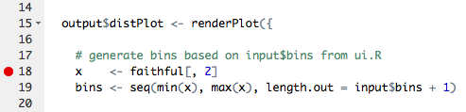
Break points
Good for inside functions
Step by step
In shiny, only works in the server side

Slide 12
Browser magic
Stops the app at the moment you chose to
You can have a button in the app!
options(shiny.error = browser) – just before the error

Slide 13
Browser magic
Server
UI

Slide 14
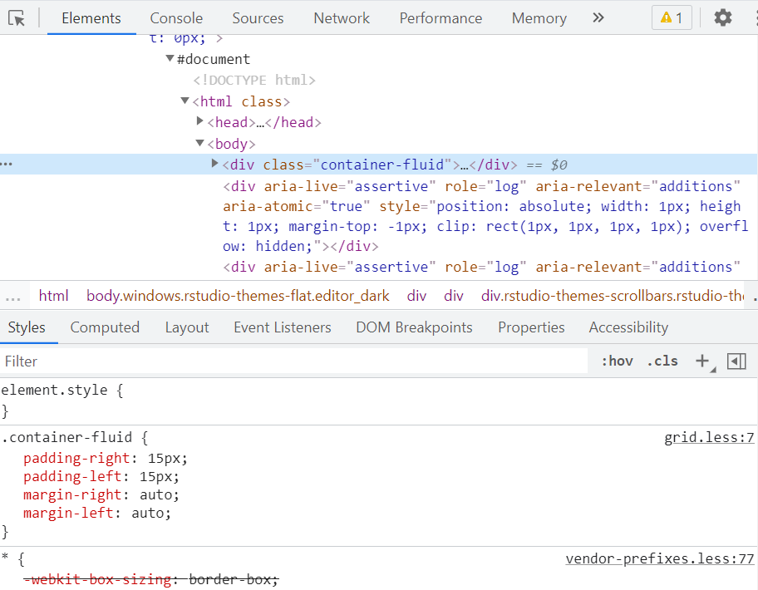
Web inspector
Using the web inspector
Useful for CSS and HTML work

Slide 15
In Shinyapps.io
Logs of app
Very long
Can be accessed with:

Slide 16
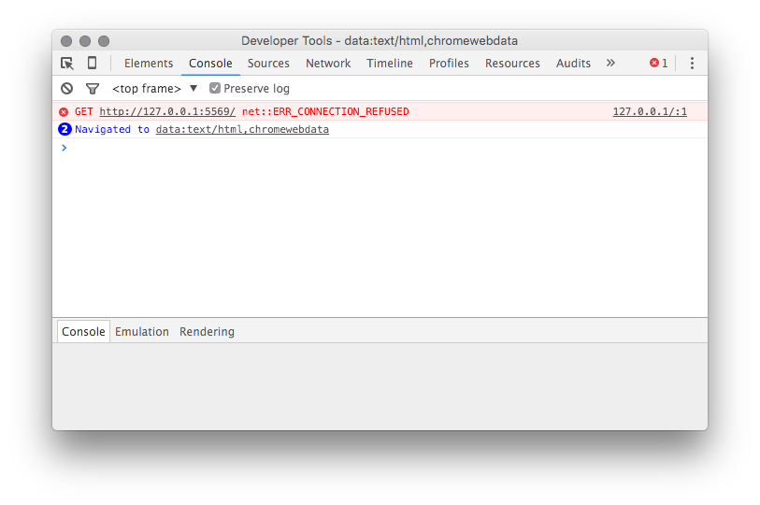
Things that I haven’t tried
JavaScript console

Slide 17
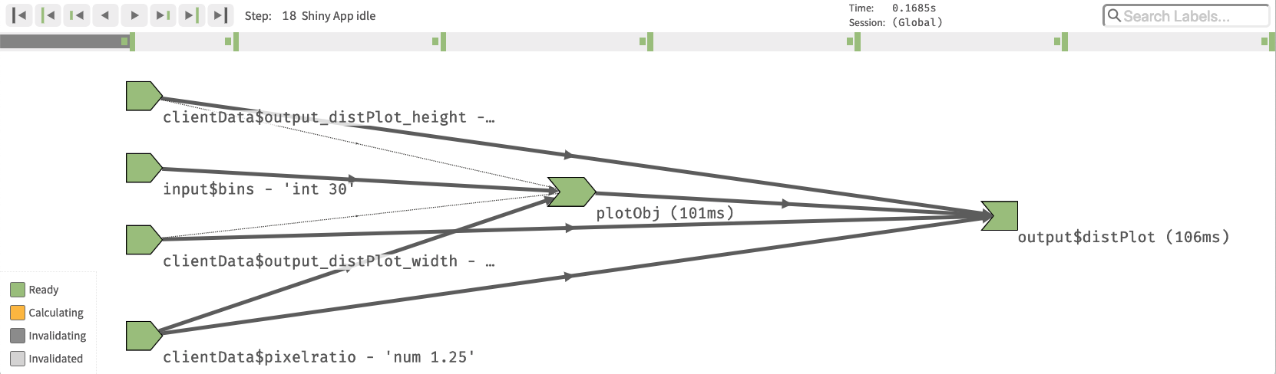
Things that I haven’t tried
Reactive log

Slide 18
Things that I haven’t tried
Showcase mode

Slide 19
Shinytest package
Creates tests that can be automated
To test changes in packages, changes in code

Slide 20
Last resorts
Reproducible example to stack overflow
Time consuming, sometimes the reproducible example works!
Look through issues in GitHub (or file one yourself)

Slide 21


Slide 22
Some useful links
https://support.rstudio.com/hc/en-us/articles/205612627-Debugging-with-RStudio
https://shiny.rstudio.com/articles/debugging.html
https://whattheyforgot.org/debugging-r-code.html
https://rtask.thinkr.fr/blog/a-little-trick-for-debugging-shiny/
https://rstudio.github.io/shinytest/articles/shinytest.html

